Slide 1

SYNOPSIS Presentation
on
Connect2life
by
<<Devansh Batta>> <<202410116100058>>
<<Brijesh Sharma>> << 202410116100052>>
<<Devesh Alan>> <<202410116100061>>
<<Bobby Karnik>> << 202410116100051>>
Session:2025-2026 (III Semester)
Under the supervision of
Dr. Neelam Rawat
Department Of Computer Applications
KIET GROUP OF INSTITUTIONS, DELHI-NCR, GHAZIABAD-201206

Slide 2
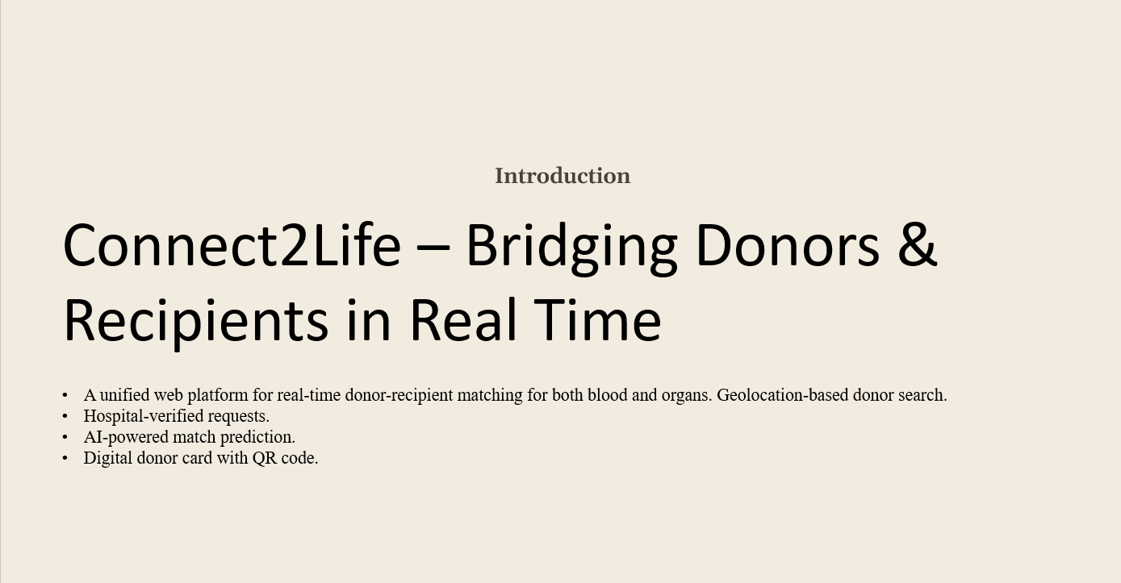

Slide 3
Problem Statement
• India loses 12,000 lives daily due to unavailability of timely blood and organ donations.
• Donor-recipient matching is slow & fragmented.
• Existing platforms are either blood-only or organ-only, lack real-time updates, and don’t prioritize emergencies

Slide 4
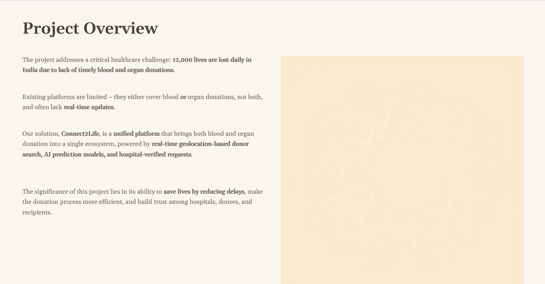

Slide 5
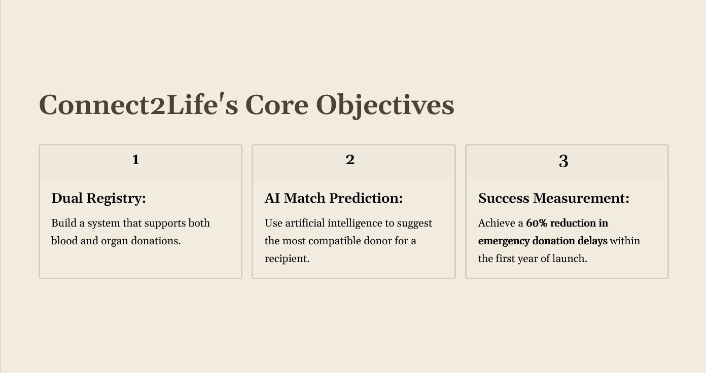

Slide 6
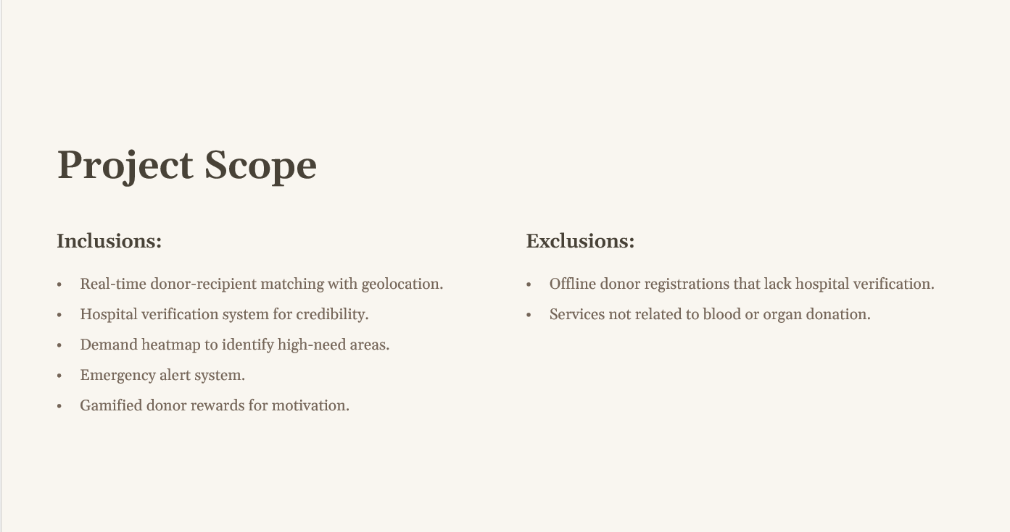

Slide 7
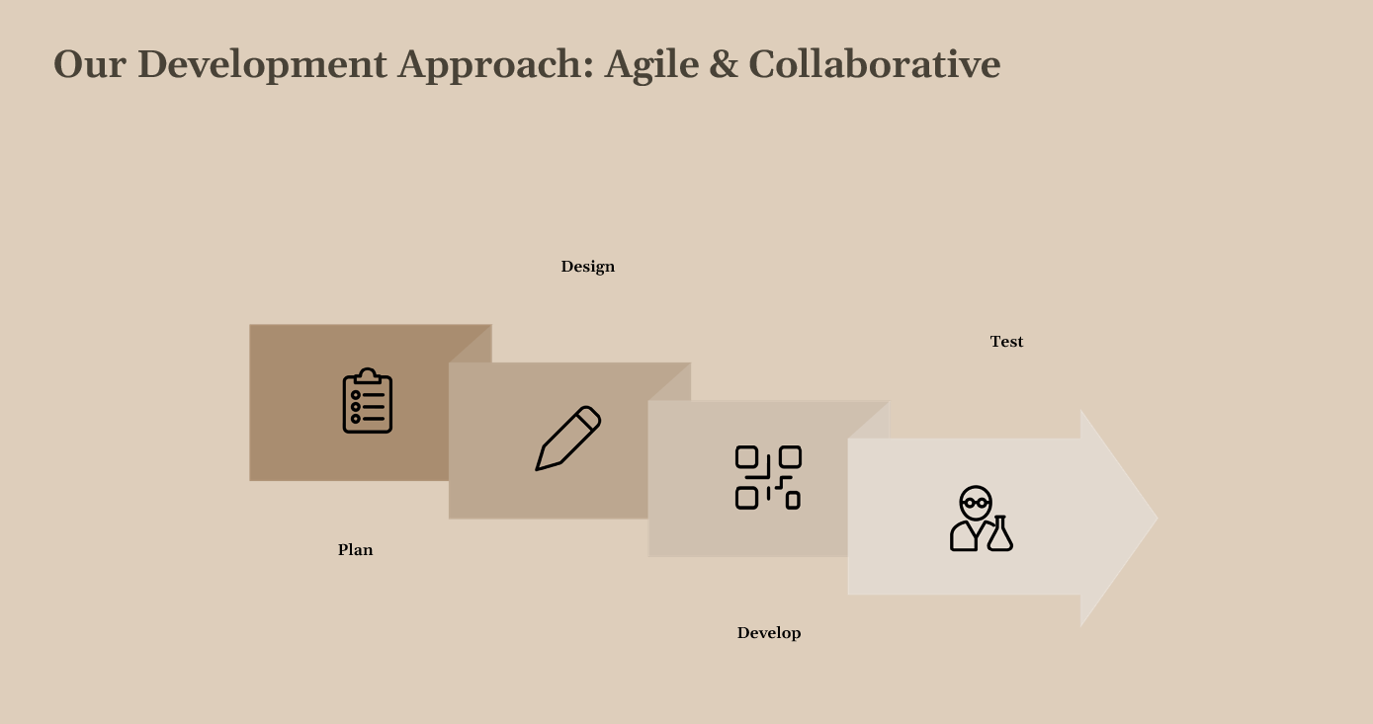

Slide 8
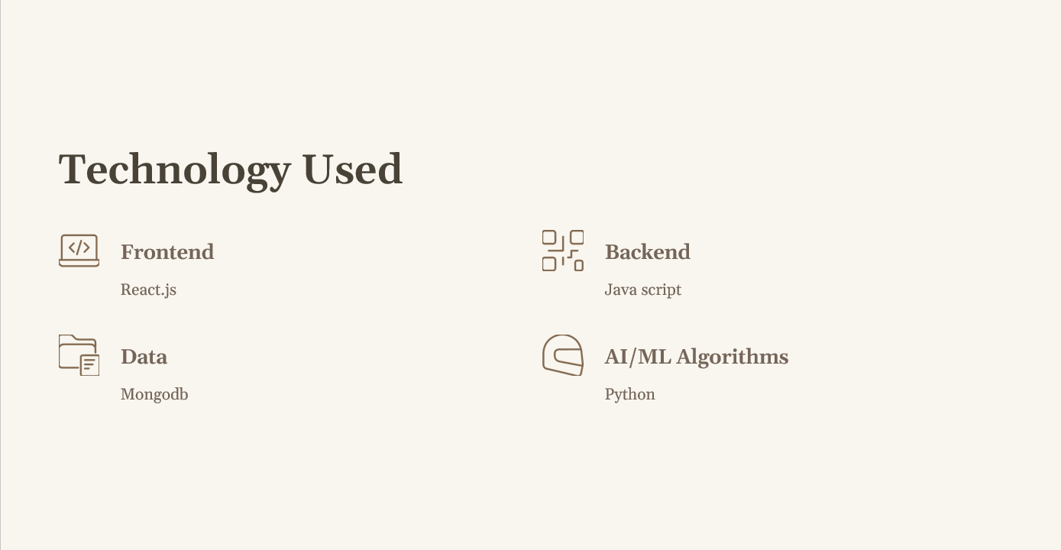

Slide 9
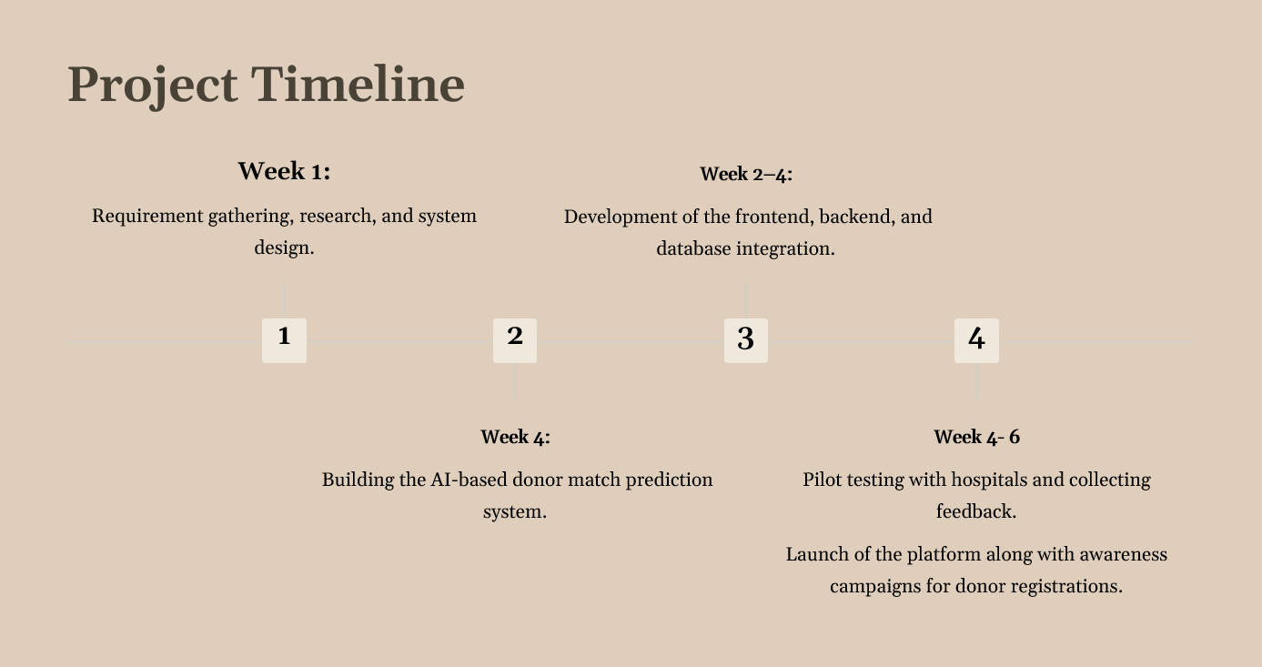

Slide 10
